Slide 1
INDOOR HUMAN BEHAVIOUR IDENTIFICATION USING Wi-fi signals
Shreyans Shah

Slide 2
Overview
Introduction
Research papers
FreeSense: Indoor Human Identification with Wi-Fi Signals
A Survey on Behaviour Recognition Using Wi-Fi Channel State Information
Understanding and Modeling of Wi-Fi Signal Based Human Activity Recognition
Notes:
First paper is about Human Identification and the other two papers are about Human behavior recognition

Slide 3
introduction
Human identification and behavior recognition plays a significant role in the area of Human-Computer interaction.
Current methods such as fingerprint and iris based sensors require user to be close to the sensing device.
Researchers have used cameras, radars or wearable sensors but these approaches have some limitations:
Vision-based approaches only work with line-of-sight coverage and rich-lighting environment.
60GHz radar solutions can offer an operation range of tens of centimeters, and the devices are not widely deployed in our daily life.
Wearable sensor-based approaches require people to wear some extra sensors.
Notes:
Fingerprint and Iris need user to be close to device
Vision based methods only work in LOS and Rich lighting
Radar solutions work in range of a few centimeters
Wearable sensors require people to wear extra sensors

Slide 4
Why use wifi
WiFi is very popular and is available everywhere so it has low deployment cost.
Researchers are using WiFi signals for studies like indoor localization, gesture recognition, etc.
WiFi signals can be easily collected, processed, analyzed and monitored to give accurate results in low noise environments.
WiFi signals get reflected and there is a change of path whenever human body is present in its path.

Slide 5
Channel state information (csi)
CSI gives fine grained information regarding WiFi communication.
Specifically, CSI describes how the signal propagates from the transmitter to the receiver and reflects the combined effects of the surrounding objects.
There are multiple subcarriers in CSI and each subcarrier contains the information of phase shift and attenuation of the signal.
Therefore, CSI contains information that is more sensitive to environmental variations caused by moving objects.
Notes:
CSI provides detailed information about Wifi communication
There are multiple Subcarriers in CSI with each having information about attenuation and Phase shift
It is more sensitive to variations caused by moving objects

Slide 6
Indoor human identification using freeSense
This paper proposes an approach for human identification using WiFi signals in domestic environments.
Each person has specific influence pattern on the WiFi signals while moving and this influence can be captured by CSI time series of WiFi.
Techniques used for CSI waveform-based human identification are:
Principal Component Analysis (PCA)
Discrete Wavelet Transform (DWT)
Dynamic Time Warping (DTW)
FreeSense is more Privacy-Preserving compared to existing methods.
Notes:
PCA is used for reducing signal dimensions
DWT is used to compress the signal size and preserve frequency and phase changes
DTW is used to do feature extraction

Slide 7
Problem analysis
To enhance the identification performance, it is important to determine the functional window in CSI sensing.
WiFi signal has more notable fluctuation when people walk across the LOS path.
Computation of signals from 30 subcarriers from 3 antenna leads to high computational cost.
PCA is used to reduce dimensionality.
DWT is used to compress LOS waveform.
DTW is used to compare two waveforms.
The route of walking and amplitude of CSI
Notes:
The PCA is a technique for dimensionality reduction of a large dimension system using the idea that most of the information about the signal is concentrated over some of the features

Slide 8
Detailed design of system
CSI values are collected using WiFi NICS
Noise is removed using Butterworth filter
To extract feature from the CSI time series, PCA is performed in each TX-RX antenna pair to reduce the dimension.
CSI time series is segmented to find starting and ending time of each LOS waveform.
Discrete Wavelet Transform is used to compress these waveform, which can preserve most of the time and frequency domain information.
Human identification is done using k-nearest neighbor (KNN) classifier based on Dynamic Time Warping
Noisy Data
Denoised Data

Slide 9
Experimental setup
9 people were recruited as volunteers and each of them provided 40 samples.
They were asked to walk across the line-of-sight to make a training set.
20 samples were used to train the classifier and 94.5% identifier accuracy was achieved for 2 people and dropped to 75.5% for 9 people.
Accuracy increased with increase in training set samples

Slide 10
limititations
The experiment can achieve more than 88% accuracy with 6 subjects as family members but accuracy might be affected by factors such as distance from transmitter or crossing manners of LOS path.
This experiment was conducted under one-person environment and presence of more than one person can affect the accuracy of human identification. In future the work can be extended to presence of multiple users in an indoor environment.
Notes:
External factors affect accuracy of the results

Slide 11
Techniques for Behaviour Recognition Using CSI
Behaviour recognition has many applications such as:
Health monitoring for elderly people
Activity recognition in smart homes
Other IoT based applications
In existing system, user has to wear a device equipped with gyroscope and accelerometer
This paper introduces passive monitoring system based on wireless signal.
When a person engages in an activity, body movement affects the wireless signals and changes the profile of the signals

Slide 12
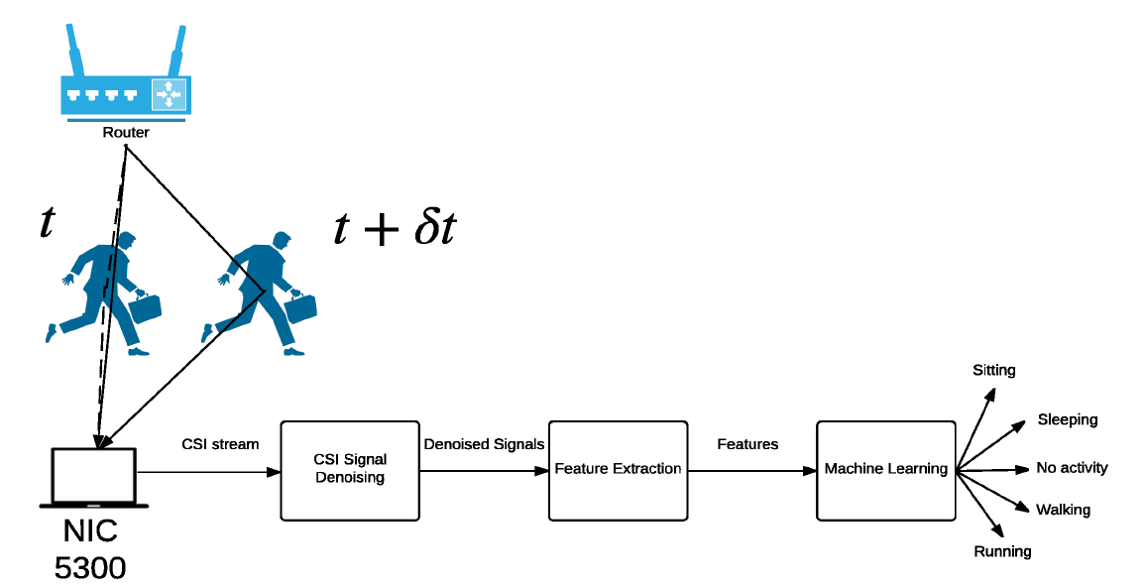
The scheme of common activity recognition techniques.

Slide 13
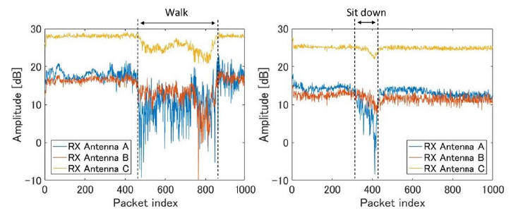
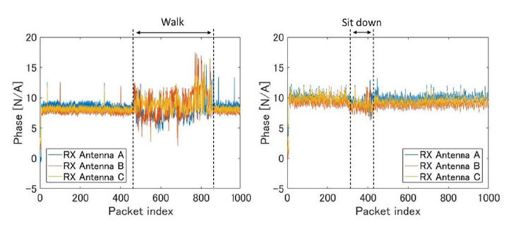
De-noising the received signal
When a person does any activity like walking or sitting down, there is a change in CSI amplitude which is clearly observed.
Again Principal Component Analysis can be applied to de-noise the received data and reduce dimensions of signal.
This data can be sanitized further using phase sanitization technique to remove effect of errors in phase
Phase Sanitization
Notes:
The PCA is a technique for dimensionality reduction of a large dimension system using the idea that most of the information about the signal is concentrated over some of the features

Slide 14
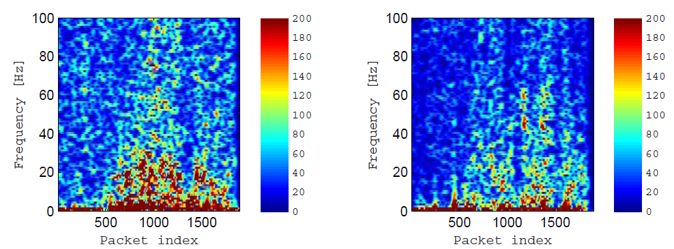
Feature extraction
One way to extract features from a signal is to transform it to another domain, such as frequency domain.
Fast Fourier Transform (FFT) can be used for this purpose.
DWT can also be used which reduces the size of data so it becomes suitable for machine learning purposes
Spectogram for walking and running using FFT
Notes:
Two methods for feature extraction:
Fast Fourier Transform (FFT)
Discrete Wavelet Transform (DWT)
DWT becomes more suitable for machine learning purposes

Slide 15
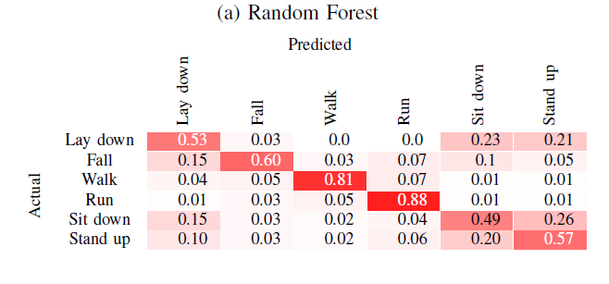
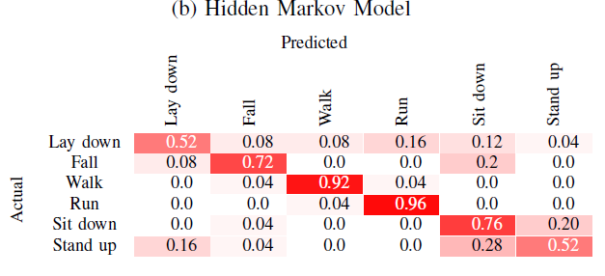
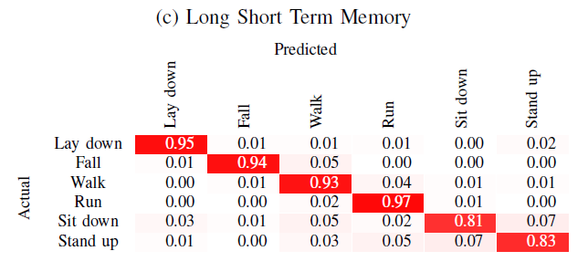
Machine learning techniques
Notes:
Long Short Term Memory (LSTM) uses its own preprocessing and takes more time than Random Forest

Slide 16
limitations
WiFi transmission rate should be high enough(2500 packets per second) to capture movements of a person or else the results are not accurate enough.
These methods are still limited to single user activity detection and needs MIMO receivers for detecting activities of multiple users.

Slide 17
Modeling of WiFi Signal Based Human Activity Recognition
This paper introduces CARM (CSI based human Activity Recognition and Monitoring system)
CARM uses previously explained methods such as FFT and DWT represent data in frequency domain.
This data is then used in Hidden Markov Model(HMM) to build CSI activity models for multiple movement states.
The result is also used to plot spectrograms of training data to observe changes in frequency during various activities.

Slide 18
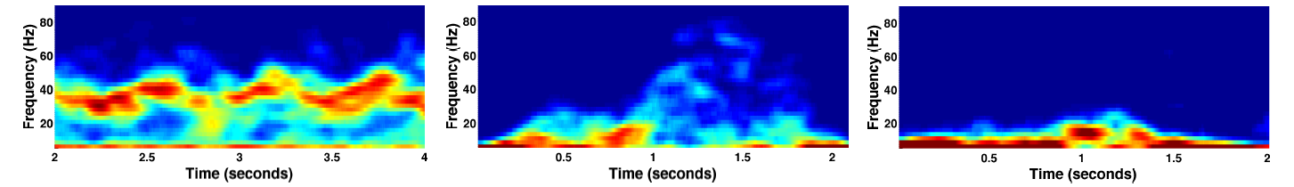
CSI Spectograms for walking, Falling and Sitting down

Slide 19
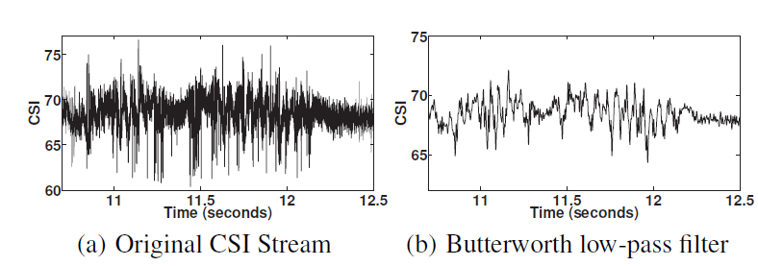
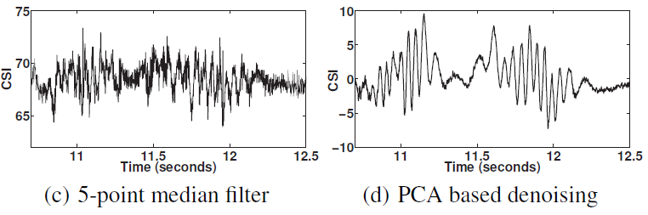
De-noising signals with sampling rate of 2,500 samples per second

Slide 20
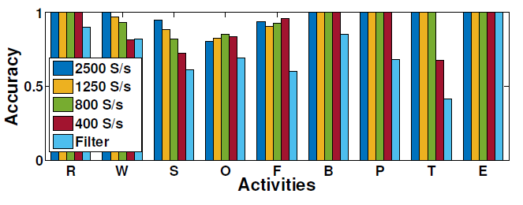
Activity recognition
Feature extraction in CARM is done using HMM and then activity recognition is performed using new data.
when the sampling rate is 2,500 samples per second:
CARM achieves an average cross validation accuracy of 96.5% across all activities.
Except for “sitting down”, “opening fridge” and “falling”, CARM achieves close to 100% accuracy.
Fig:- Impact of sampling rates on accuracy Accuracy

Slide 21
References
FreeSense: Indoor Human Identification with Wi-Fi Signals Tong Xin, Bin Guo, Zhu Wang, Mingyang Li, Zhiwen Yu
A Survey on Behaviour Recognition Using Wi-Fi Channel State Information Siamak Yousefi, Hirokazu Narui, Sankalp Dayal,Stefano Ermon, Shahrokh Valaee,
Understanding and Modeling of Wi-Fi Signal Based Human Activity Recognition Wei Wangy, Alex X. Liuyz, Muhammad Shahzadz, Kang Lingy, Sanglu Luy

Slide 22
Questions?

